Slide 1
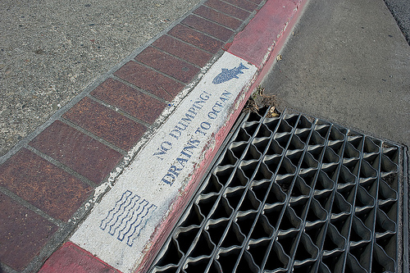


What Does MS4 Mean to You?
A study of sewer and storm drain cross contamination
Presented by Michael Hill, PE and Steve Jepsen
Presented to:

Slide 2
MS4 and Sanitary Sewer
What will we talk about?
A little about surface water quality regulations
What a sewer agency is doing about them
The goal:
A look at future regulations
Start thinking of how MS4 might affect us…

Slide 3
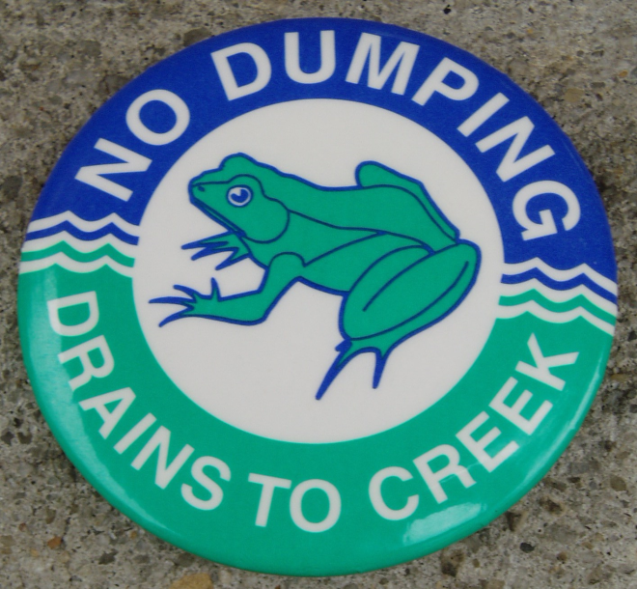
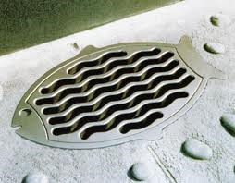

What is MS4?
Municipal
Separate
Storm
Sewer
System

Slide 4
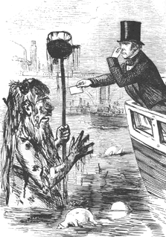
The History of Water Quality
The Roman Empire – 800 BC
The Industrial Revolution – 1800s
The Clean Water Act – 1972
CMOM - 2002
WDR - 2006
MS4 – 2013 (latest version)

Slide 5
The New MS4
Watershed based
  Water Quality Improvement Plan
  (WQIP)
  NGO review
Numerical Limits
  TMDL – Total Maximum Daily Limit
  San Diego County estimate 20 year TMDL cost in billions of $
Bacteria TMDLs
Manage new projects to pre-development conditions
Extensive monitoring

Slide 6
MS4 and Sanitary Sewer
Aren’t we glad we don’t have to deal with this?
Think again…
Bacteria TMDLs are expensive
Storm Water programs do not have direct funding
What is a potential source of bacteria?
How do you prove the sewer is not a source?

Slide 7
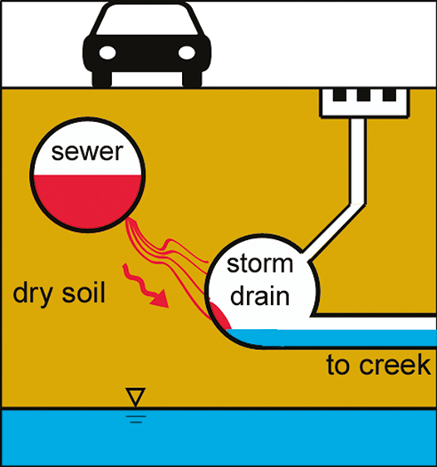
Sewer Exfiltration/MS4 Infiltration
Identify Potential Areas of:
  Sewer Exfiltration
    And –
  Storm Drain Infiltration
Uncommon Situation
Where to Start?
(Sercu et al. 2011, ES&T)

Slide 8
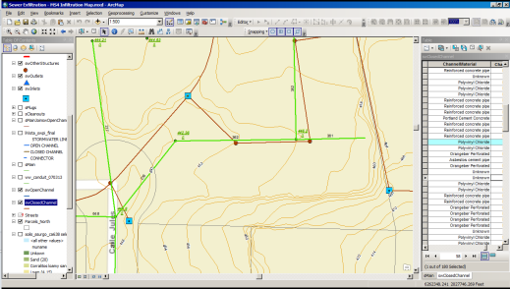
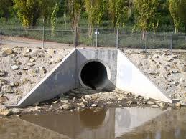

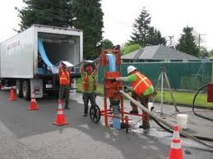
Phased Approach
Each phase narrows search
  Ph I – “Desktop” Portion (GIS, rec dwgs, CCTV)
  Ph II – Field Investigation (CCTV Storm Drains)
  Ph III – Field Testing (dye, soil, sampling)
  Ph IV – Pipe Rehab
Phase I Completed

Slide 9
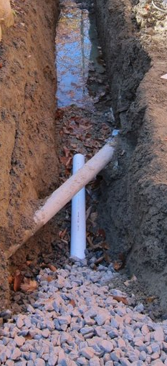
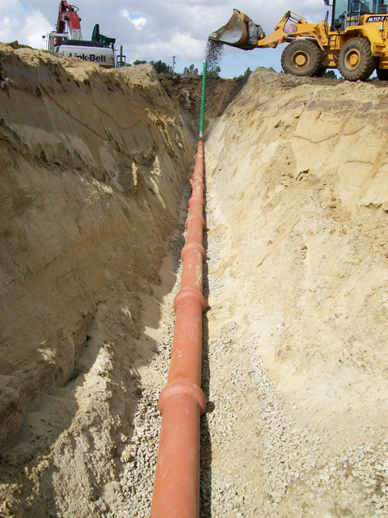
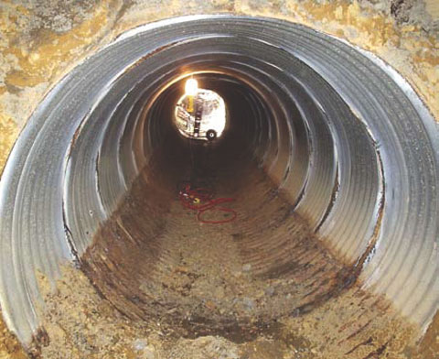
“Desktop” Investigation
Contributing Factors
  Pipe Crossings
  Vertical Separation
  Sewer Pipe Condition
  Storm Drain Mat’l/Size
  Soil Type

Slide 10
Sewer Collection System
Watershed study area:
  507 sewer pipes
  93,000 ft (18 miles)
Watershed Study Area

Slide 11
Sewer and Storm Drain System
Watershed Area: 3,200 acres (5 sq.mi )
Investigate:
  Closed Pipe
    And –
  Open Channels
Open Channel Storm Drain
Closed Channel Storm Drain
Sewer Pipe

Slide 12
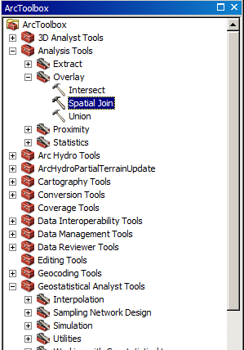
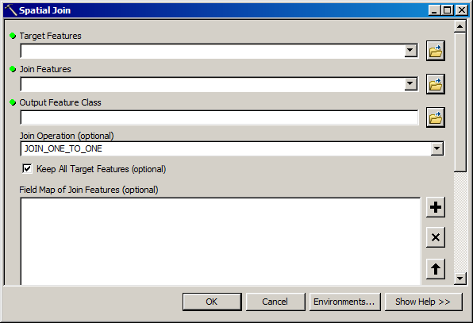
Sewer/Storm Drain Crossings
GIS Spatial Queries
Worked w/ City GIS staff
Join storm drain data to sewer data
Join soil data
Sewer Crossing Storm Drain

Slide 13
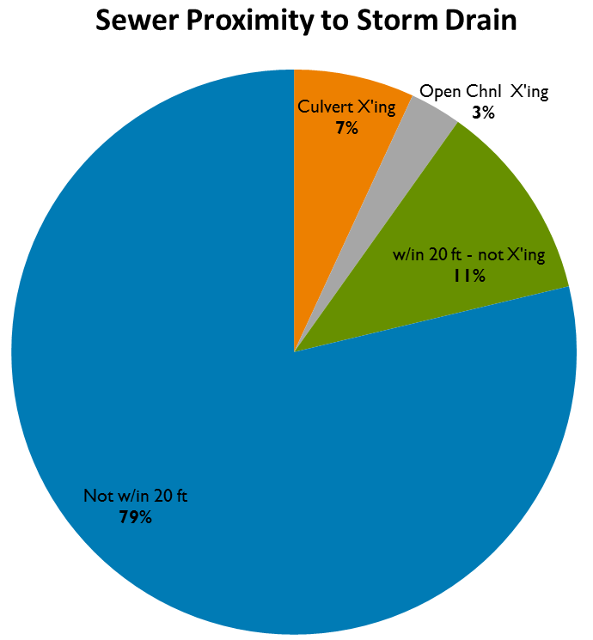
GIS Selection Results
107 (21%) sewer pipes selected for further study
Depends on GIS accuracy

Slide 14
Data Analysis
Exported GIS Data to Excel
Compiled data into categories
Missing Data → Use record drawings

Slide 15
Scoring Matrix
5 Categories, 12 sub categories
Weighted scoring

Slide 16
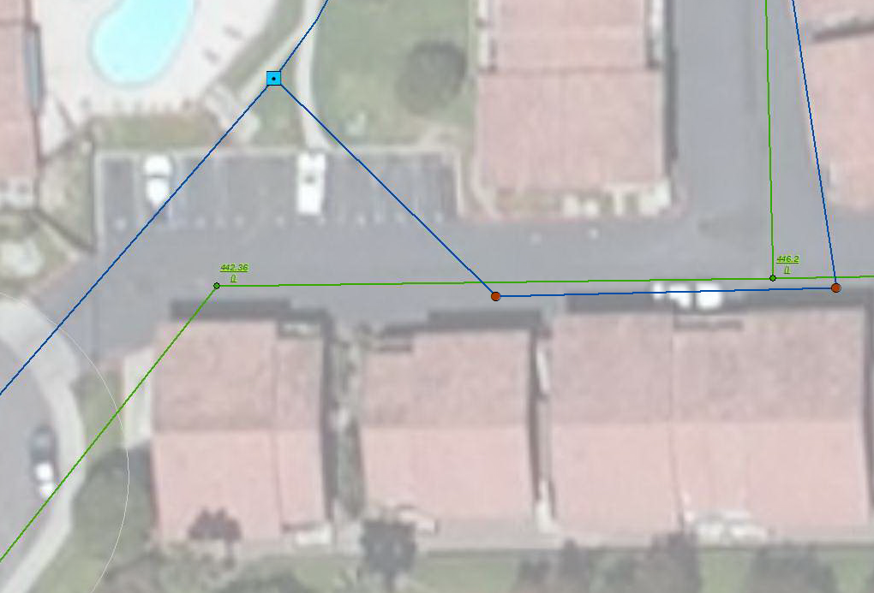
Example Site
Sewer-Storm Drain Crossing
No storm drain invert elevation in GIS
Need IE for scoring

Slide 17
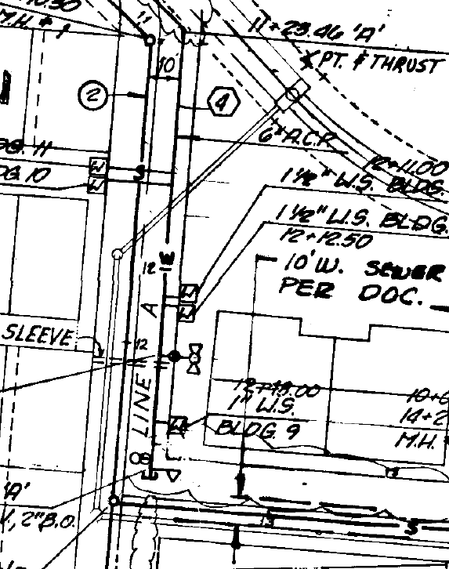
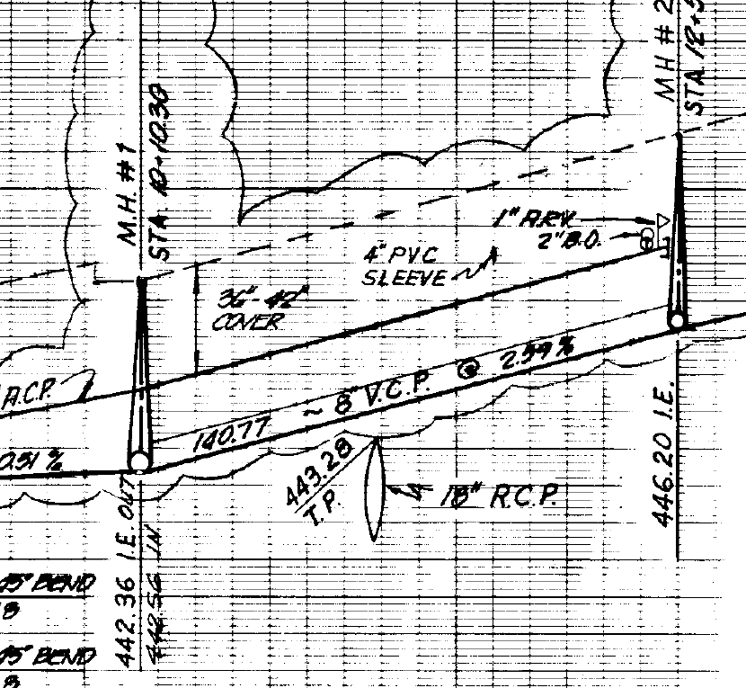
Example Site (Cont’d)
Review record drawings
1 ft

Slide 18

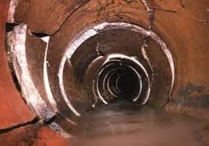
Sewer Pipe Deficiency Assessment
Recent CCTV available for all mains
Defects relative to exfiltration

Slide 19
Phase I Priority Ratings
Based on scoring matrix
Narrow search down
  19 of 507 (4%) sewer pipes above storm drain
  12 of 19 (2%) also cross storm drain
  6 of 12 (1%) also have defect
  2 of 6 (0.3%) also in sandy soil → highest rating
Unaccounted variables/factors

Slide 20
Phase II and III
Further Narrow Search
Potential sites
Further field work to verify or deny
Rehab pipe is last step

Slide 21
Questions?
Michael Hill, P.E.
Dudek
mhill@dudek.com
760.479.4124

