Slide 1
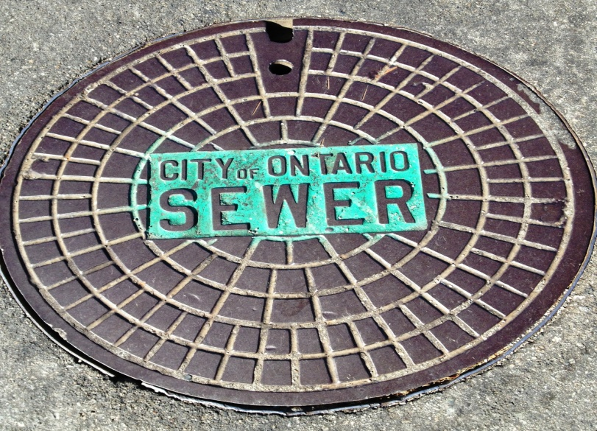
Wastewater Operations and Maintenance

Slide 2
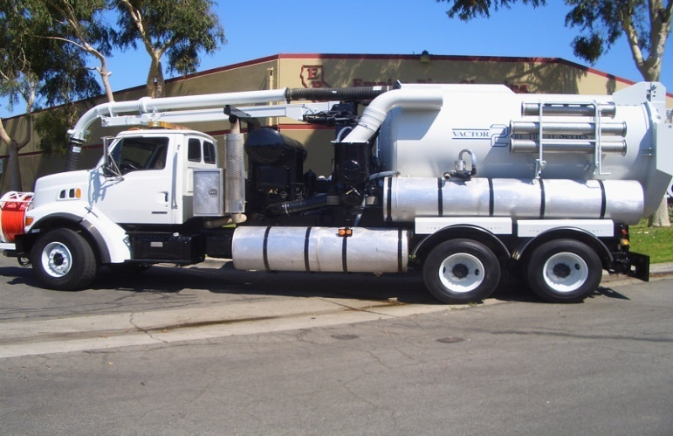
Equipment and Personnel
2 Combination trucks(Vactor)
1 Jetter truck(Vactor)
1 CCTV Van
2 Bypass pumps
6 Personnel

Slide 3
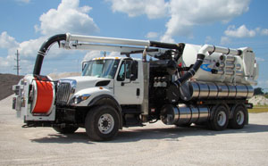
Ontario’s Collection System
365 miles of pipe
7,582 manholes & cleanouts
3 lift stations
11,588’ of forcemains
9 inverted siphons
Average sewer load ~18.75 MGD
Mostly VCP, 4” - 42” diameter
Mostly constructed 1950-1990, but some as early as 1895

Slide 4
Line Cleaning Program
Based on a Grid System
58 Grids
Access data base

Slide 6
Grids and jetting forms
SEQ | FACILITYID | LENGTH | DATE | EMPLOYEE1 | EMPLOYEE2 | EQUIPMENT | COMMENTS
1 | F11CL1006 | 171
2 | F11CL1005 | 99
3 | F11CL1034 | 99
4 | F11CL1035 | 145
5 | F11CL1004 | 200
6 | F11CL1003 | 152
7 | F11CL1031 | 165
8 | F11CL1032 | 351
9 | F11CL1008 | 160
10 | F11CL1009 | 154
11 | F10CL1005 | 216
12 | F10CL1007 | 157
13 | F10CL1025 | 275
14 | F10CL1008 | 270
15 | F10CL1003 | 219
16 | F11CL1001 | 216
17 | F11CL1002 | 140
18 | F11CL1007 | 138
19 | F10CL1002 | 275
20 | F10CL1020 | 228
21 | F10CL1017 | 225
22 | F10CL1006 | 217
23 | F10CL1023 | 60
24 | F10CL1018 | 241
25 | F10CL1019 | 301
26 | F10CL1016 | 222
27 | F10CL1004 | 161
28 | F10CL1013 | 82
29 | F10CL1011 | 368
30 | F10CL1012 | 194
31 | F10CL1010 | 290
32 | F10CL1009 | 110
33 | F10CL1014 | 171
34 | F10CL1015 | 166 |  |  |  |  | Traffic
35 | G10CL1029 | 224
36 | G10CL1028 | 296
37 | G10CL1027 | 296 |  |  |  |  | Traffic
38 | G10CL1026 | 276 |  |  |  |  | Traffic
39 | F10CL1001 | 262
40 | G10CL1046 | 341

Slide 7
Data Base

Slide 10
Graph

Slide 11
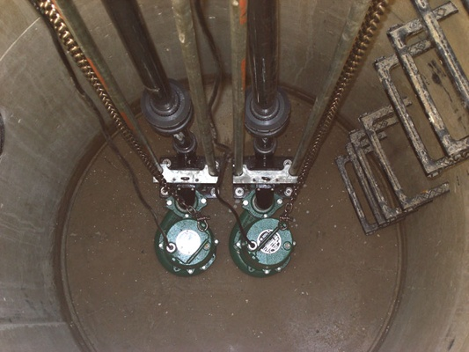
Lift Stations (3)
Daily rounds
Monthly Maintenance
6 Month wet well cleaning

Slide 12
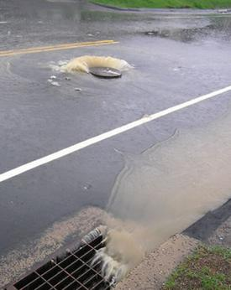
Bypass storm channel emergency plan
Area of spill
Bypass set up procedures
Communication with field personnel
Mock set up drills

Slide 13
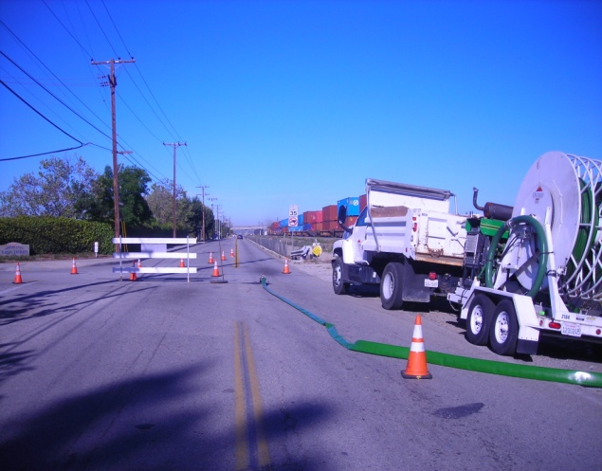
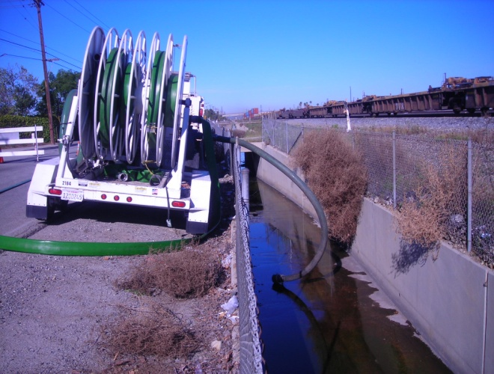
#1 Benson & State

Slide 14
Spill containment Location
Benson and State
Road closure between Benson and Oaks on State st. (Refer to traffic control SOP)
Sand bags to control flow within the storm drain.
Set Bypass pump to divert flow from channel back to the sanitary sewer system.(K10MH111)
Use 25’ suction hose
Use 75’ discharge hose
Vactor #1 on standby
Vactor #2 on standby
Jetter Truck to be used to wash down and clean the storm drain.

Slide 15
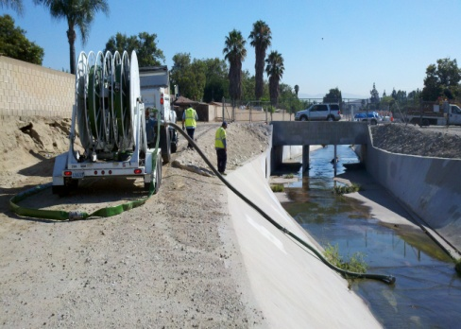
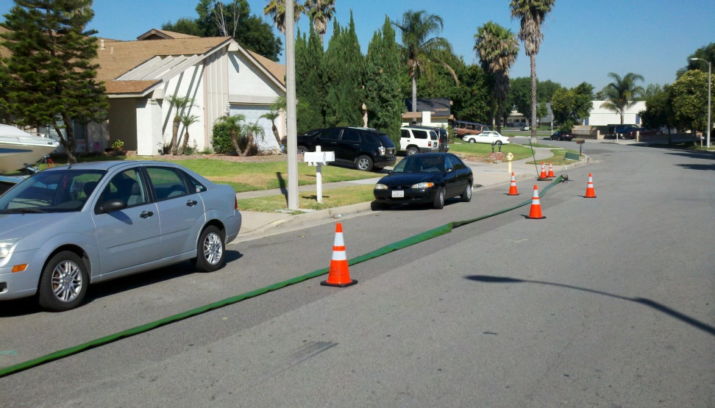
4# Woodlark & Walnut

Slide 16
Walnut and Woodlark
Road closure between Arcadian Shores and Woodlark on Walnut st. (Refer to traffic control SOP)
Sand bags to control flow within the storm drain.
Set Bypass pump to divert flow from channel back to the sanitary sewer system.
Use 50’ suction hose
Use 150’ discharge hose
Vactor #1 on standby
Vactor #2 on standby
Jetter Truck to be used to wash down and clean the storm drain.

Slide 17
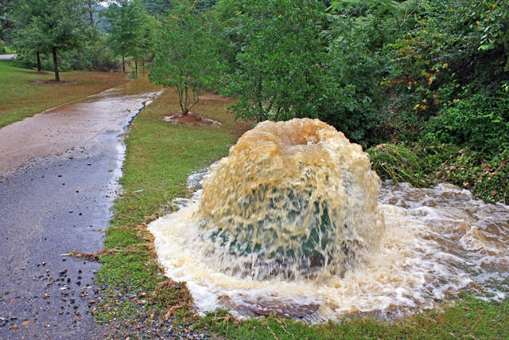
When all else fails

Slide 18
Mutual Aid
IEUA
Cucamonga Valley Water
City of Upland
City of Fontana
City of Chino Hills
City of Chino
City of Montclair

