Slide 1
COMPONENTS FOR SUCCESSFUL COMPOST FACILITY OPERATIONS
SCAP Biosolids Committee Meeting
August 2, 2012
Notes:
This is the main title slide. Insert the presentation main title in all caps and add a sub-header / title if necessary.

Slide 2
AGENDA
Facility Siting Considerations
Composting Technologies
Permitting
Regulatory Compliance
Process Control
Compost Quality

Slide 3
FACILITY SITING CONSIDERATIONS
Location, Location, Location!
Regulations
Nearby Compost Market
Sensitive Receptors
Public Education/Politics
Education Begins Early
Keep it Simple
Remember the Benefits
Diversion
Soil Enhancement
Erosion Control
Don’t ignore the public/politics

Slide 4
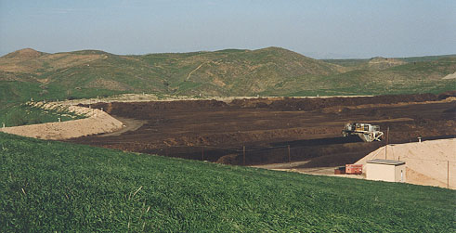
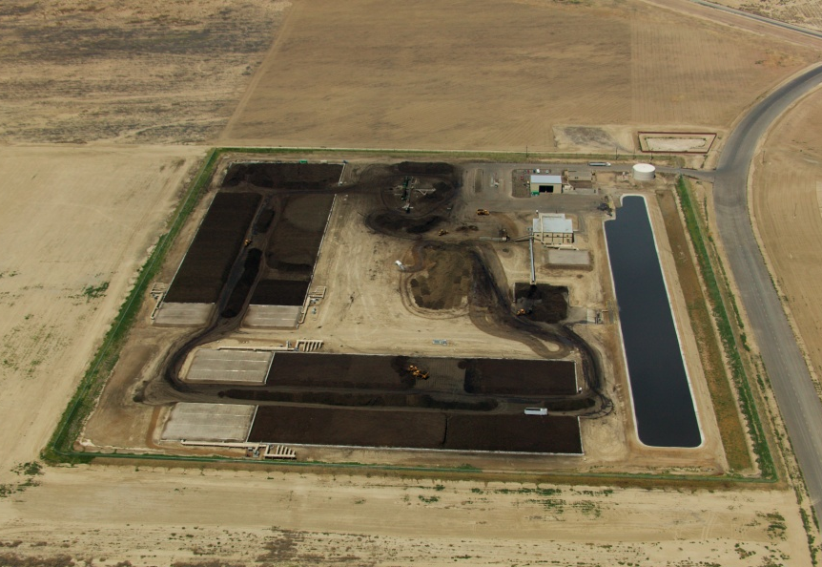
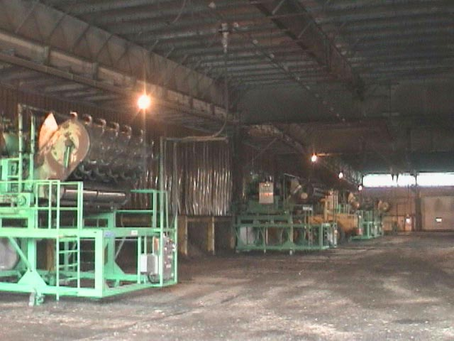
COMPOSTING TECHNOLOGY
Windrow
Negative Aerated Static Pile with Biofiltration
In-vessel

Slide 5
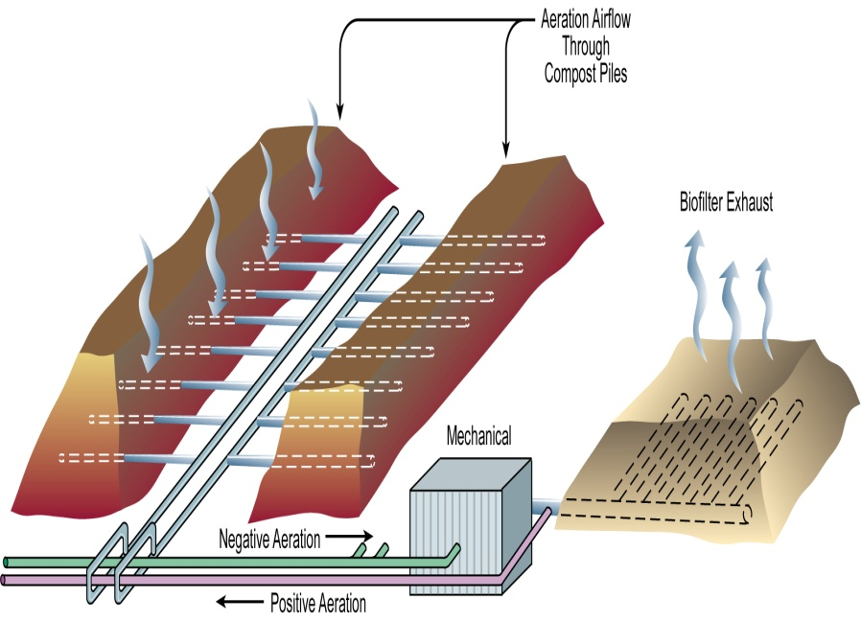
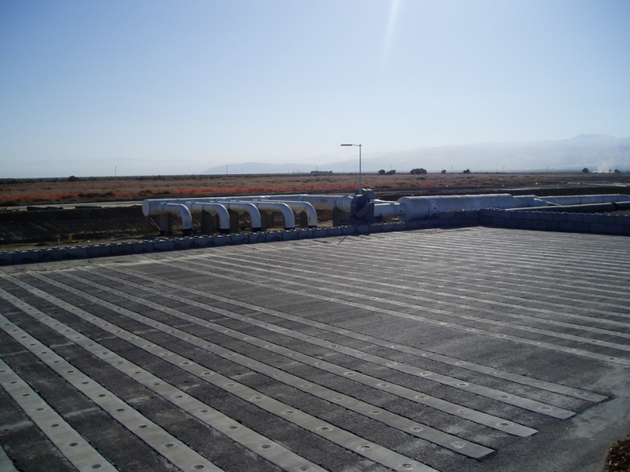
COMPOSTING TECHNOLOGY:
Negative Aerated Static Pile Composting

Slide 6
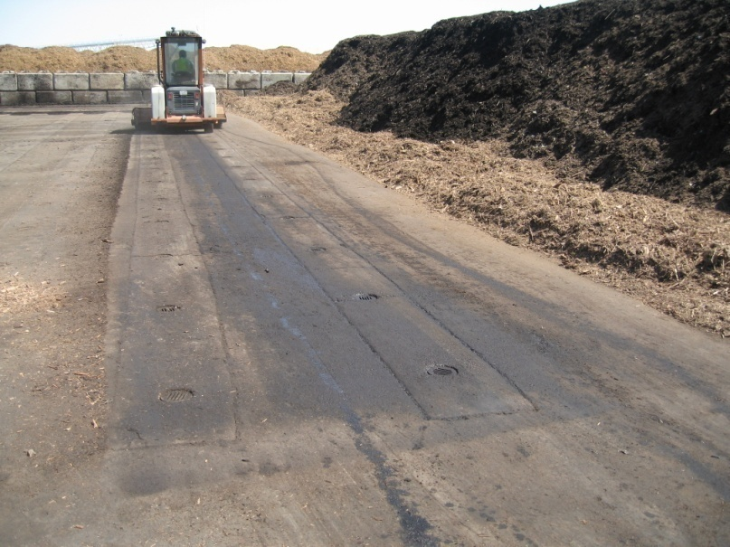
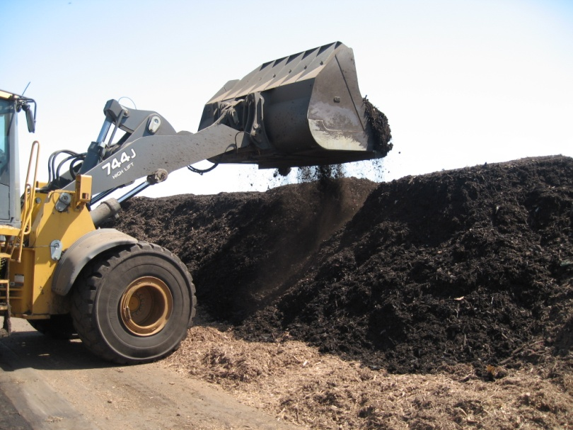
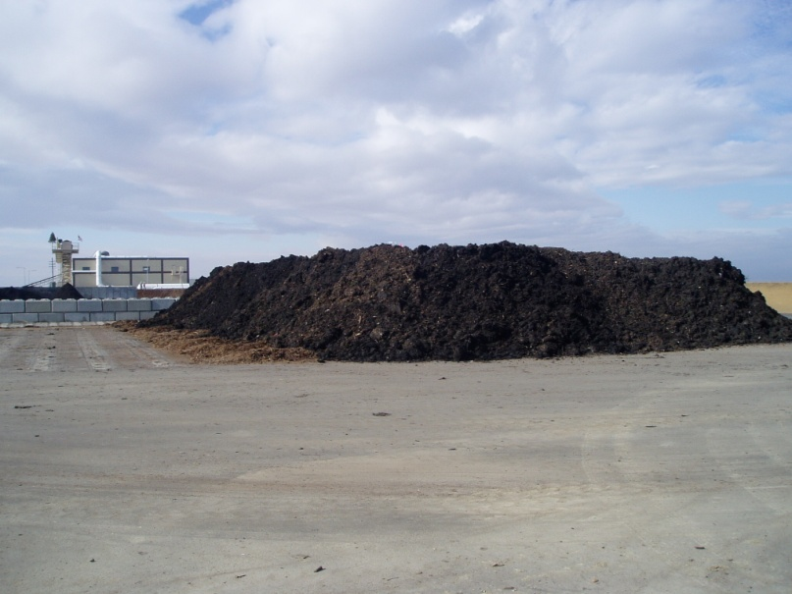
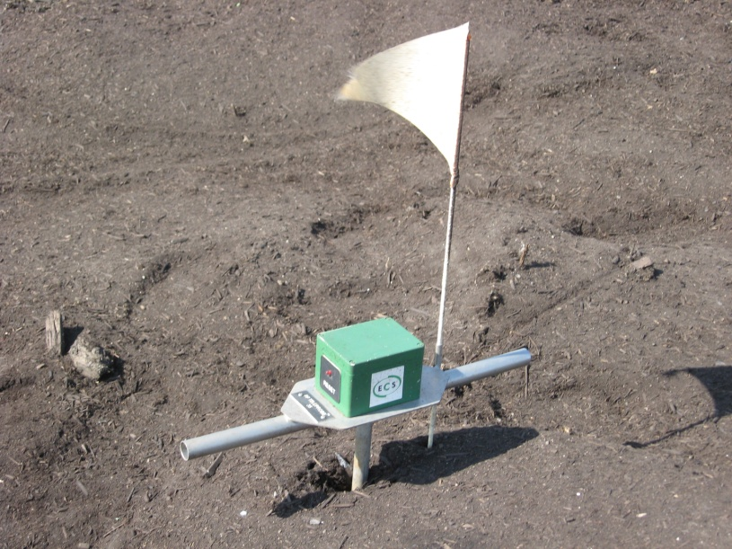
COMPOSTING TECHNOLOGY:
Negative Aerated Static Pile Composting

Slide 7
PERMITTING
Local Conditional Use Permit
CEQA
CA Solid Waste Facility Permit
Report of Compost Site Information
Odor Impact Minimization Plan
Regional Water Quality Control Board
Local Air District Permit
U.S. EPA Registration

Slide 8
REGULATORY
Inbound Materials Monitoring
Biosolids
Carbon Feedstocks
Process Water Management
Ground Water Monitoring
Special Occurrences
Source Testing
Compost Sampling
C.C.R. Title 14, Chapter 3.1, Article 7
Metals Concentrations (max)
Pathogen Reduction (PFRP)
Sampling Requirements

Slide 9
PROCESS CONTROL PARAMETERS
Control Points
Feedstock Handling
Mix Ratios
Moisture
Aeration Rates
Temperature/PFRP

Slide 10
THE COMPOSTING PROCESS
Water
CO₂
Heat
Odors?
Feedstocks
Microorganisms
Compost
Oxygen
Water

Slide 11
COMPOST FACILITY FEEDSTOCK-PROCESS-MARKET
Start here or here
Identify and quantify Feedstocks
Develop and adjust recipes
Analyze Markets
Collect or receive feedstocks
Assess
Compost Facility
Market and distribute
Process:
Grind, Mix, Compost, Cure, Screen, etc.

Slide 12
THE KEY PROCESS VARIABLES for Control of the Composting Process
Initial feedstock mix
Pile moisture
Pile aeration
Pile shape and size
Pile temperature
Composting retention time

Slide 13
FEEDSTOCKS: YOUR RAW MATERIAL
Chemical Composition
Organic Matter, Nutrients, Degradability
Physical Characteristics
Moisture, Bulk density, Heterogeneity
Other
Contamination, Cost, Availability, Regulations

Slide 14
FEEDSTOCK SUMMARY
Each feedstock has certain attributes
The RECIPE is how feedstocks are combined
Composting system designed for feedstocks
Regulations are always partly based on feedstock

Slide 15
OTHER CONSIDERATIONS
Health & Safety
Initial Mix Ratios
Moisture
Aeration
Temperature
Time
Curing/Maturity
Testing

Slide 16
SUMMARY: Key Initial Parameters for Composting

