Slide 1


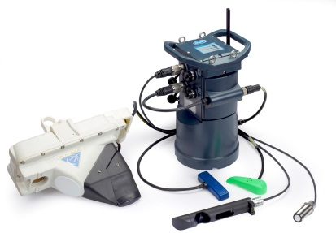
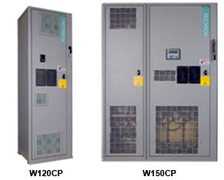

Exclusive Representatives for:
INSTRUMENTATION
MARSH
McBIRNEY
SIGMA
CLAMP-ON FLOW METERS
MAGNETIC FLOW METERS
ULTRASONIC LEVEL
COLLECTION SYSTEM
FLOW MONITORS &
AUTO SAMPLERS
VARIABLE FREQUENCY DRIVES
WE CAN PROVIDE SERVICE FOR
ANY
VFD MANUFACTURER

Slide 2
Clearwater Controls
Deragger II – Anti Ragging Device
Power Efficiency Enhancement

Slide 3
Agenda
Current Industry Situation
Deragger II The product
Deragger II Technical Specification
Western Ave Pumping Station
Power Savings
Questions

Slide 4
Current Industry Situation
Associated Press Article: Sept 2013
Wet Wipe industry in the US is a $6 billion-a-year industry
This is increasing nearly 5 percent a year since 2007 and expected to grow at a rate of 6 percent annually for the next five years.
This cost the water utilities Millions on inefficient Pumping

Slide 5
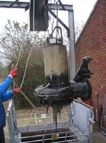
Current Industry Situation
Traditionally, lift and manually unblock pumps
Reactive response, not always at the most convenient time of day!
High risk of pollution from SSO
Significant Increase in Power Consumption
Typical blockage

Slide 6
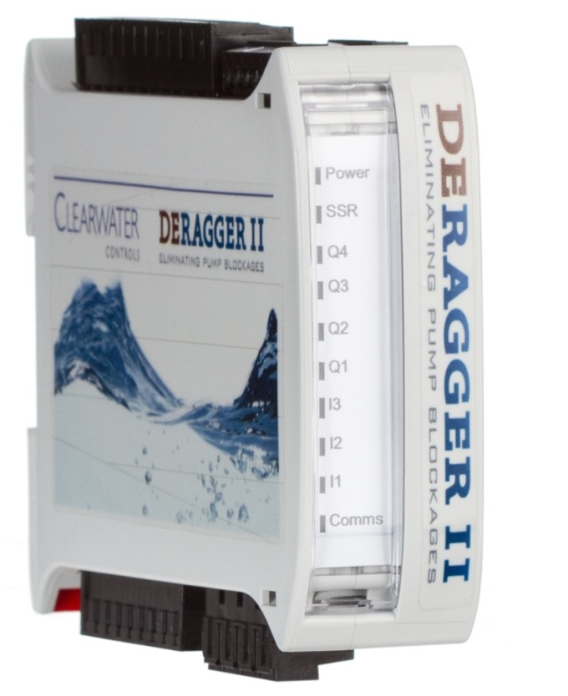
Deragger II
The Solution

Slide 7
Deragger II
Anti-ragging electronic pump control device
In Line, Delta/Wye, VFD’s & Soft Start
Retrofit into existing control panels
Provides standard pump protection
Payback period as short as a few weeks!
0 – 1000A rated

Slide 8
Deragger II
Full 3 phase power analyzer
Designed for Fixed And Variable Speed
Small footprint 1.4”x 4”x 4.5”
No new enclosures to add
User programmable functionality
Installation requires minimal interruption to the lift station
UL Approved

Slide 9
Technical Specification
3 x Digital inputs (24Vac/dc or 110-230Vac)
4 x Relay outputs (Examples: Forward or Run, Reverse, Fault, Alarm or Star/Delta Changeover)
1 x SSR output (Examples: kW/Hr. pulse, Soft Start Run/Stop or Clean in Progress)
2 x Analog inputs (Flow, Level)
Comms: ModbusRTU, Profibus DP*
Supply Voltage:110-230Vac

Slide 10
LED Error Indications
Di1 | Di2 | Di3 | Action | Description
0 | 1 | 0 | Flashing | Analog Input Monitor Trip
0 | 1 | 1 | Flashing | Application Monitor Trip
1 | 1 | 0 | Flashing | External Trip (Digital Input or Comms)
1 | 0 | 1 | Flashing | Device Internal Fault Trip
1 | 0 | 0 | Flashing | Comms Timeout
0 | 0 | 1 | Flashing | Motor Supply Monitor Trip
1 | 1 | 1 | Flashing | Motor Overload Monitor Trip

Slide 11
Fault Codes
Code | Description | Possible Cause
0 | SYSTEM POWER UP EVENT | Power fail or dip
1 | SYSTEM RESET EVENT | System has automatically reset itself
0x4002 | CURRENT IMBALANCE ALARM | Windings failing on motor
0x4004 | FREQUENCY ALARM | Frequency out of tolerance
0x4009 | OVERCURRENT ALARM | Possible short circuit
0x4008 | OVERVOLTAGE ALARM | Supply voltage too high
0x400C | PHASE LOSS ALARM | One of the phases to the motor is gone
0x400E | UNDERCURRENT ALARM | Low current to motor
0x400F | UNDERVOLTAGE ALARM | Low voltage to motor
0x8000 | ANTI RAGGING TRIP | Too many clean cycles have been attempted
0x8002 | CURRENT IMBALANCE TRIP | Imbalance in current to motor check windings
0x8003 | DRY WELL TRIP | Too many dry well inhibit events check levels
0x8004 | FREQUENCY TRIP | Frequency out of tolerance
0x8005 | HARDWARE ERROR TRIP | Problem with the Deragger try powering off
0x8006 | INPUT REAL TRIP | External trip
0x8007 | INPUT VIRTUAL TRIP | Trip from Modbus
0x8008 | MODBUS TIMEOUT TRIP | Comms timeout
0x8009 | OVERCURRENT TRIP | Possible short circuit
0x800A | OVERLOAD TRIP | Motor has overloaded
0x800B | OVERVOLTAGE TRIP | High voltage to the motor
0x800C | PHASE LOSS TRIP | One of the phases to the motor is gone
0x800D | SOFTWARE ERROR TRIP | A Firmware error has occurred please reset device
0x800E | UNDERCURRENT TRIP | Low current draw by motor
0x800F | UNDERVOLTAGE TRIP | Low voltage to motor
0xFFFF | RESERVED | RESERVED

Slide 12
How does it work?

Slide 13
Static Set Point

Slide 14
Dynamic Set Point

Slide 15
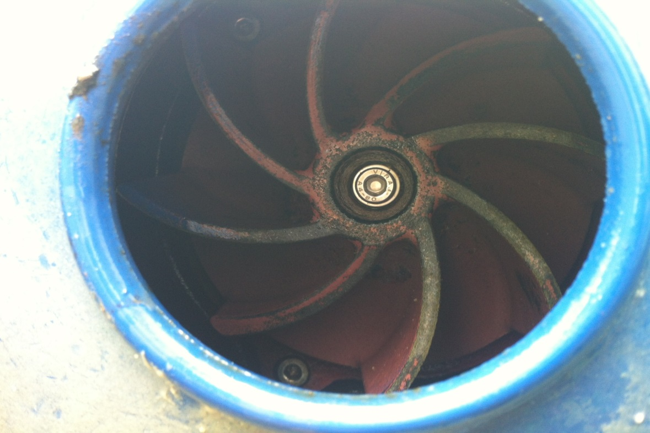
Typical Results
Clean impeller after 2 months of Deragger operation

Slide 16
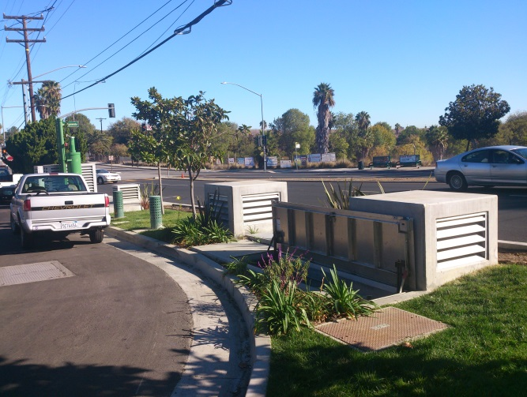
Western Ave
2 x 50HP VFD Driven Pumps
Manually lifted pumps weekly
2 x Deragger II’s installed
No Manual Cleans since November 2013
Average of 1 Automatic Clean Per Day

Slide 17
Western Ave
Pre Deragger Installation Running Current 55A
Post Running Current 52A
Reduction of 5.4% Running Current

Slide 18
Power Savings
Trial Site Anglian Water UK
Increased Flow Rates By 27%
Reduced Pump Run Time By 67%
Reduced Inrush Current By 22.4%
Increase In Overall Electrical Savings By 52%

Slide 19
Power Savings
Trip Point
Winding Damage
Bearings/Seals Damage
Wasted Energy

Slide 20
Summary
Worldwide Waste Water Industry Problem
Patented Low Cost Retrofit Solution
3 Years + Live Site Test Without Failure
2 Year Warranty
Improves pumping performance by up to 52%

Slide 21
Questions

