Slide 1
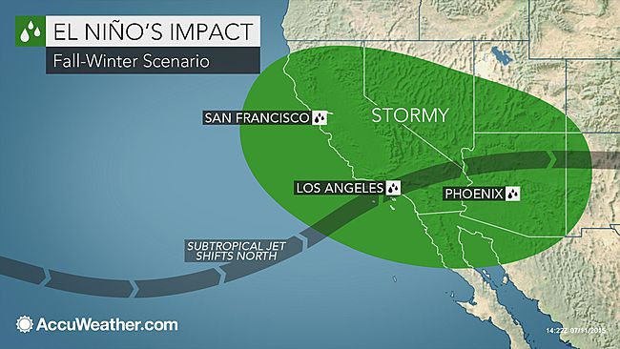
El Niño
Wet Weather Planning
SCAP Collections Meeting
November 12, 2015

Slide 2
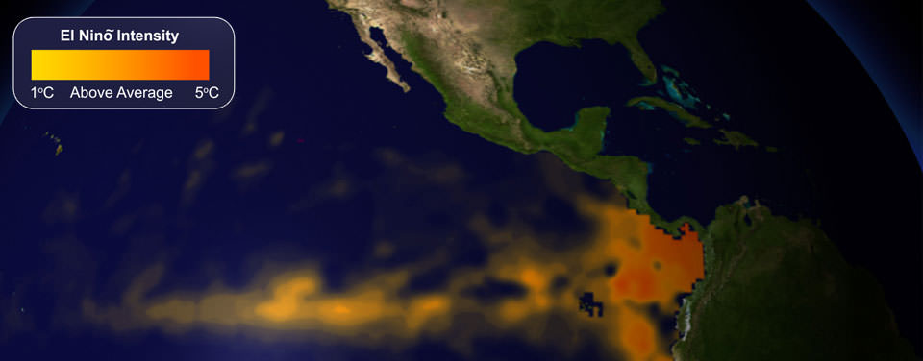
El Niño History
What is El Niño?
One phase of El Niño-Southern Oscillation (ENSO) cycle
Characterized by unusually warm ocean temperature in Equatorial Pacific
Frequency is irregular
Climate impacts vary
Previous Strong El Niño’s
2004-05
1997-98
1983-84
How does 2015 compare?
Strong El Niño

Slide 3
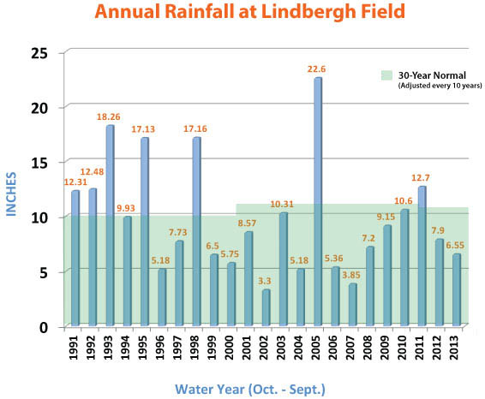
El Niño History
Rainfall History
Notes:
Southern California rainfall is highly variable
El Niño conditions influence rainfall
2014: 5.09 inches
What could happen this winter?
1983: 18.49 inches (178% of average)
1998: 17.16 inches (173% of average)
2005: 22.60 inches (210% of average)
2015: ?
History suggests 150 - 200% of average rainfall
Source: San Diego County Water Authority

Slide 4
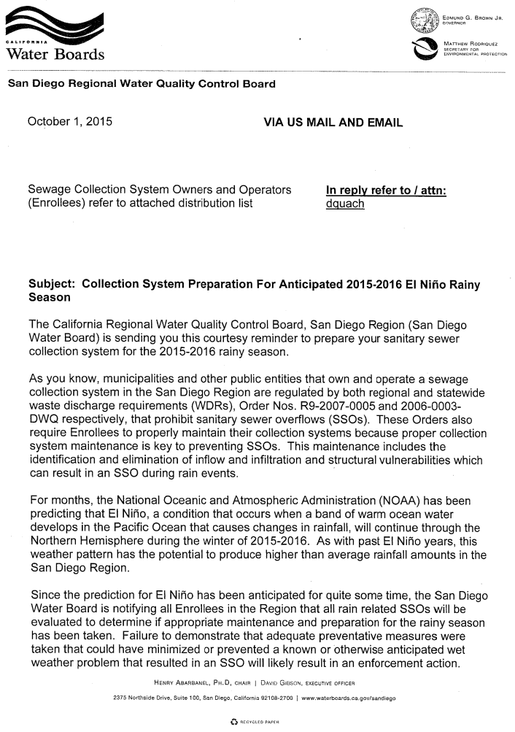
Regional Board
Regional Board Outlook
Aware of El Niño
Expects collection systems to be prepared
Will not forgive SSO’s because of El Niño

Slide 5
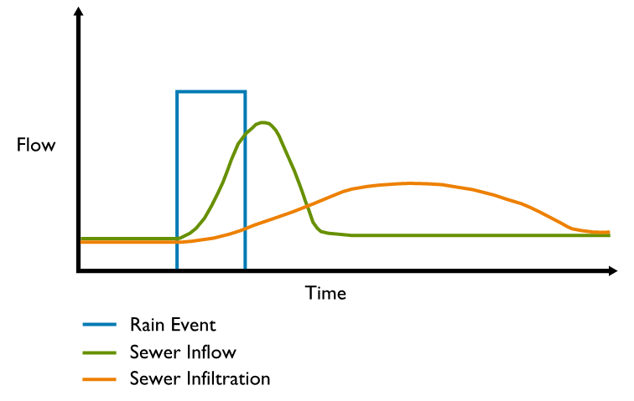
Inflow & Infiltration

Slide 6
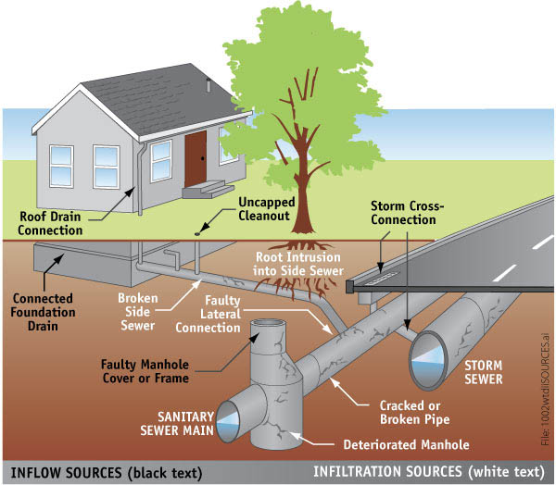
Inflow & Infiltration
Differentiating Inflow & Infiltration
Inflow contributes large volume in short time
Infiltration contributes large volume in longer time
Inflow main concern for SSO’s

Slide 7
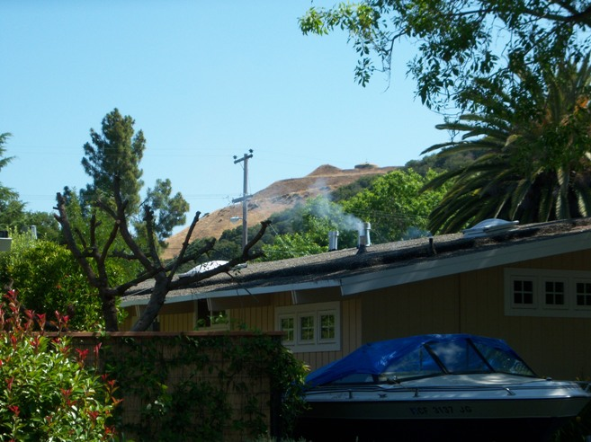
Inflow Prevention
What can be done?
Inventory & Maintain Low Flow Diversions
Install sealed manhole covers in areas of known flooding
Check all above ground creek crossings
Clear debris from pipe
Repair/Improve pipe supports
Smoke Testing

Slide 8
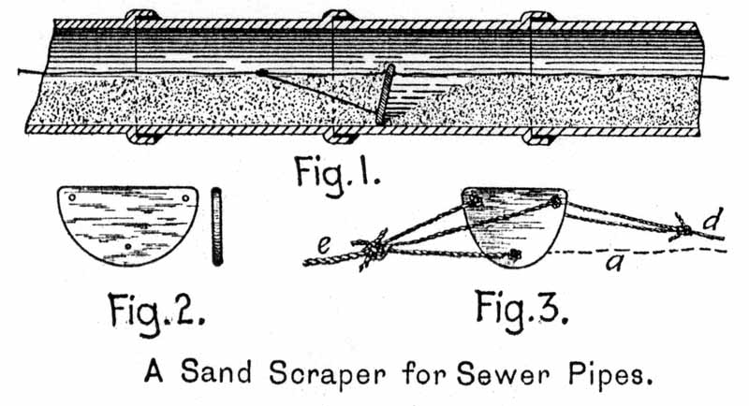
Inflow Management
What can be done?
Clean sewer lines
Pump Station weatherproofing
Emergency response plans
Bypass pumping
Standby Power
Smart covers

Slide 9
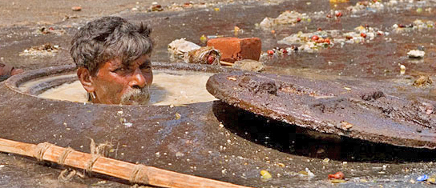
Questions & Comments

